Slide 1


Caffe Chair
Done by:
ID
219110563
219110701
Omar Abdulbaqi
Mohammed Alyami

Slide 2
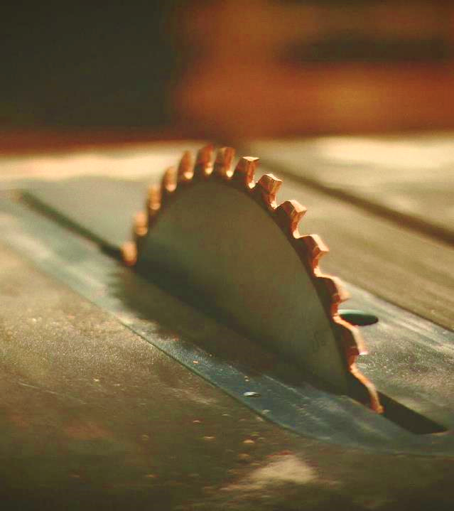
Table of content:
-Introduction
-Design Product
-List of all cost and (D, I, F, V)
-CVP analysis including BE
-Job costing by using ABC
-Master Budget
-Pricing

Slide 3
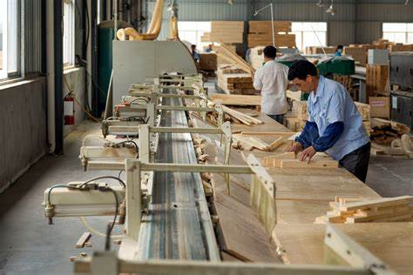
Introduction
At O&M Manufacture our capability comprehensive analysis of the production and financial planning for a furniture manufacturing project specializing in producing high-quality chairs. With an expected demand of 6,000 units per month, the business aims to achieve operational efficiency and maintain a competitive edge in the market by adopting advanced costing techniques and meticulous budget planning.

Slide 4

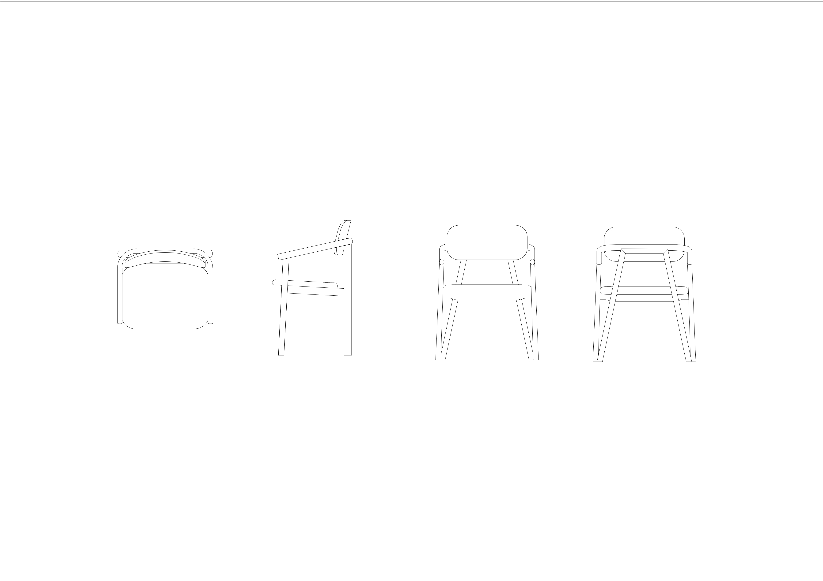
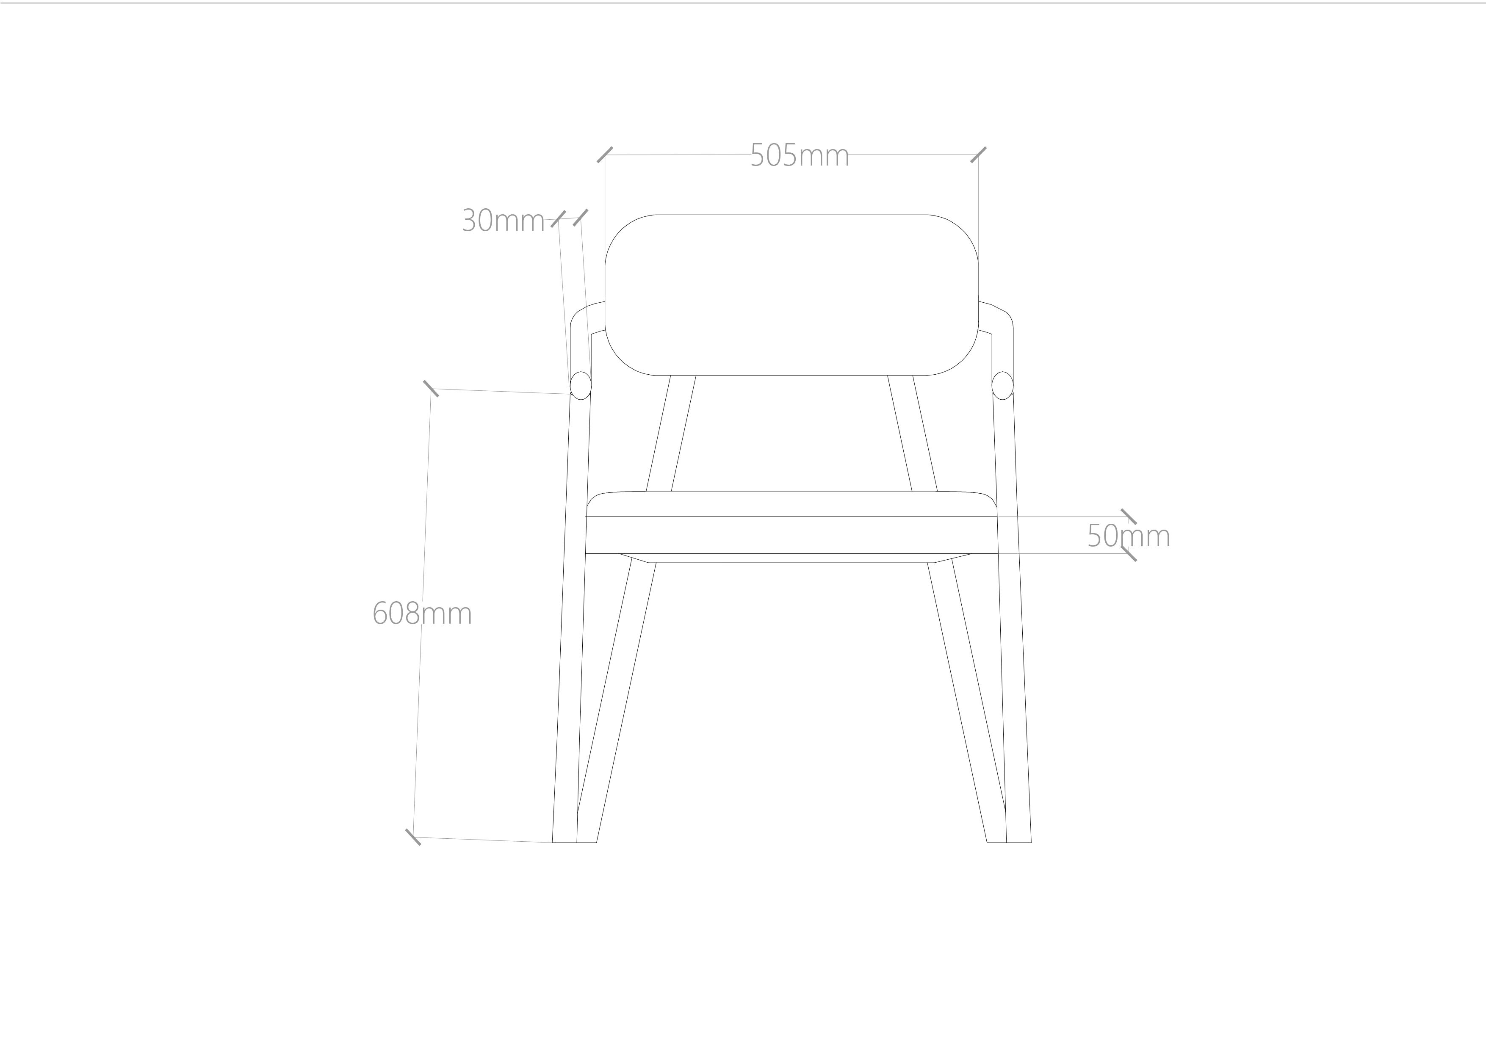
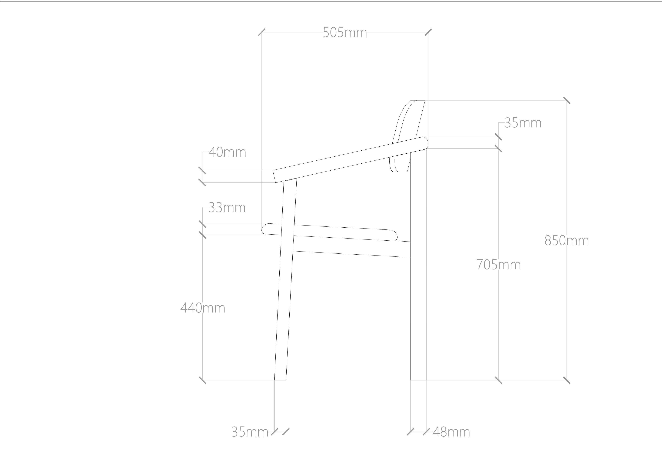
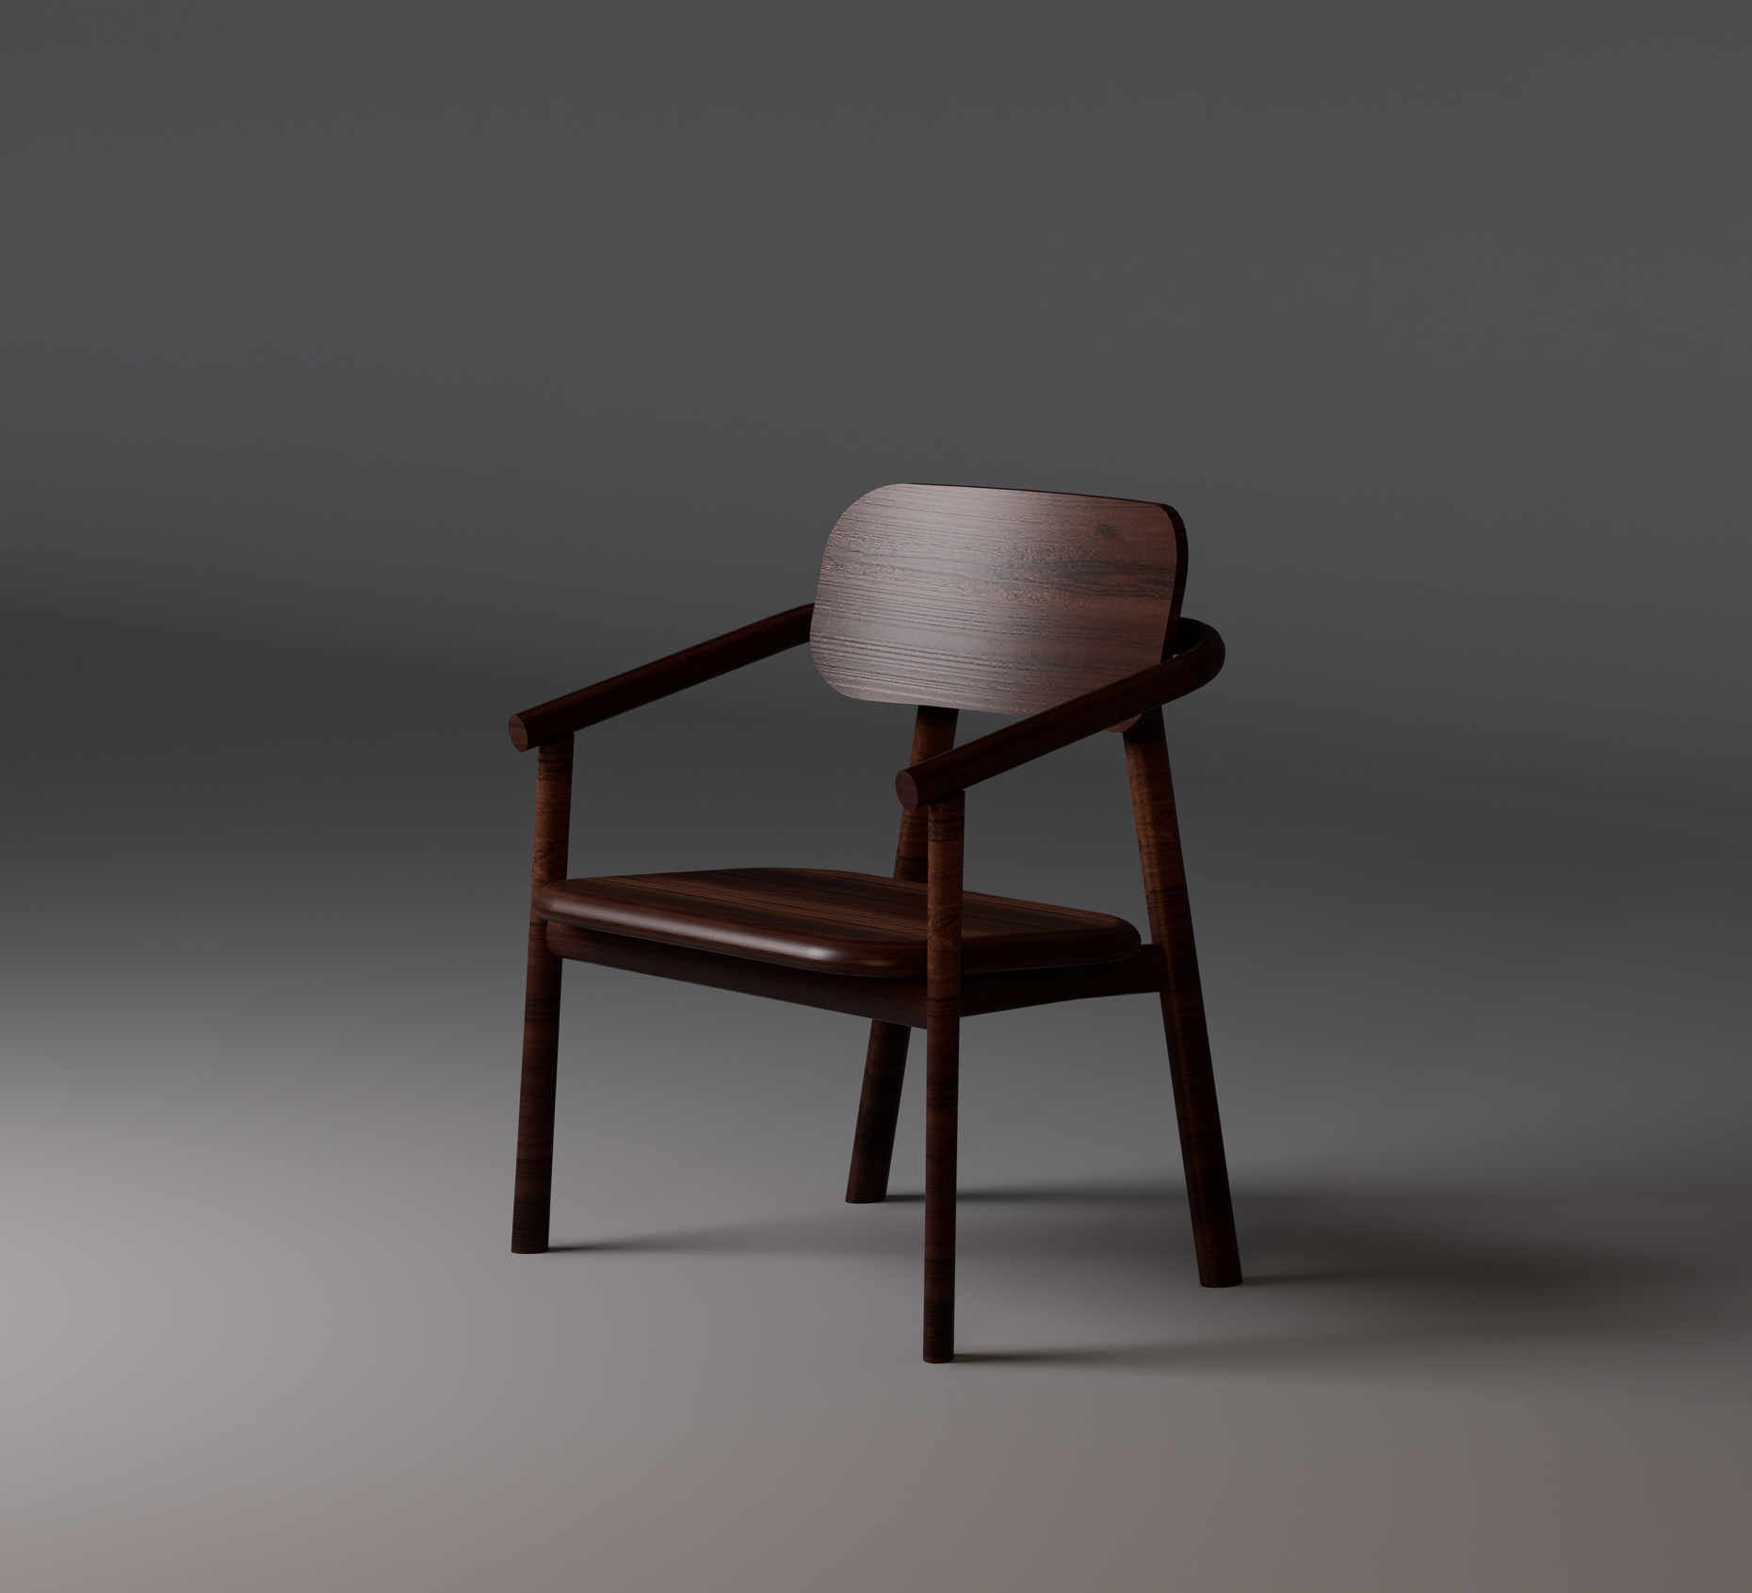
Design Product

Slide 5

List of all cost and (D, I, F, V)
Item | Cost | Fixed/ variable | Direct / indirect
Labor | $75,600 | Fixed | Direct
Insurance | $2000 | Fixed | Direct
Raw material | $576,000 | variable | Direct
Utilities | $11,000 | variable | indirect
Depreciation | $3,000 | Fixed | indirect
Supply | $1,000 | variable | indirect
Holding cost | $72,000 | Fixed | indirect
Setup | $10,800 | variable | Direct
Indirect material | $3,000 | variable | indirect
Lease | $20,000 | Fixed | indirect

Slide 6

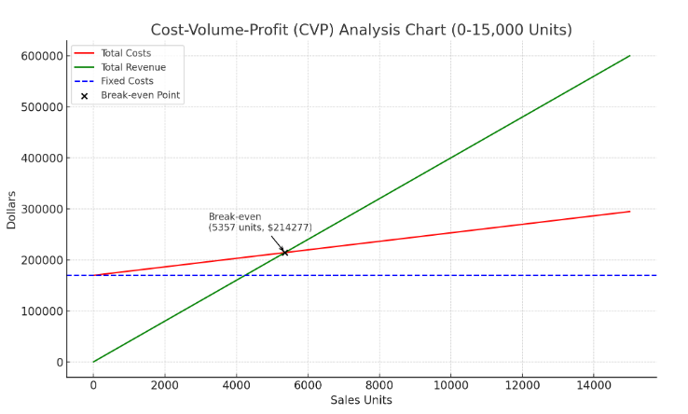
CVP Analysis
Selling price per chair is $40
Variable cost per chair is $8.34
Fixed cost is $169,600
Contribution margin per chair = selling price – variable cost
$40 - $8.34 = $31.66
Break-even point = fixed cost / contribution margin
$169,600 / $31.66 = 5357 chair

Slide 7
Job Costing
Cost component | Cost per chair ($)
Direct materials | 8.03
Direct labor | 1.05
Overhead (ABC) | 1.572
Total job cost | 10.652

Slide 8
Activity-based costing for Caffe Chair
Using activity-based costing (ABC) we figured out that the rates per chair is equal to:
Facility lease = $0.28
Holding inventory = $1
Security and depreciation = $0.142
Setup = $0.15
Overhead per chair = $1.572
Activity | Total O.H($) | Cost driver | Driver units | Activity rate | Cost per chair
Facility lease | 20,000 | # of units | 72,000 | 0.28 | $0.28
Holding cost | 72,000 | # of units | 72,000 | 1 | $1
Security | 10,200 | Labor hour | 72,000 | 0.14 | $0.14
Setup cost | 10,800 | # of setups | 12 | 900 per setup | $0.15

Slide 9
Master Budget
Sales Budget
Production Budget
Direct Materials Budget
Direct Labor Budget
Cost of Goods Manufactured (COGM) Budget
Income Statement Budget
Overhead Budget
A master budget is a comprehensive financial planning document that includes operating and financial budgets for the business.
6. Cost of Goods Manufactured (COGM) Budget Cost Component Annual Cost ($) Direct Materials $577,440 Direct Labor $75,600 Overhead $107,000 Total COGM $760,040
7. Budgeted Income Statement Item Annual Amount ($) Sales Revenue 2,880,000 Cost of Goods Sold (COGS) $760,040 Gross Profit $2,119,960
Operating Expenses: $2,078,760
Net Operating Income $41,200
1. Sales Budget:
Annual Total: 72,000unit * $40 =$2,880,000
2. Production Budget Annual Total 72,000 unit
3. Direct Materials Budget Total $577,440 4. Direct Labor Budget Total $75,600
5. Overhead Budget Overhead Item Annual Cost ($) Facility Lease 20,000 Holding Costs 72,000 Utilities (Electricity) 10,000 Utilities (Water) 1,000 Depreciation 3,000 Supplies 1,000 Total Overhead 107,000

Slide 10

Pricing
Price of the chair, we compared it to the market. The average price is $45, and we want to earn $29.3 per markup, so the price of the chair will be $10.652 + $29.3 = $40
total cost = $766,944
cost per chair = $10.652
“Business opportunities are like buses. There's always another one coming.”
“
RICHARD BRANSON

Slide 11

Summary
At O&M , we breakdown the costs, categorized it into direct, indirect, fixed, and variable components. These include labor, raw materials, utilities, lease expenses, and setup costs. Using Activity-Based Costing (ABC), the cost of producing each chair was accurately calculated, allowing for a more precise allocation of overhead expenses. Further, a detailed master budget is presented, encompassing key elements such as the sales forecast, production plan, direct materials and labor budgets, overhead allocations, and the projected income statement. The findings demonstrate that the total cost per unit is $10.65, aligning with the company’s target pricing strategy of $40 per chair.

Slide 12
Thank you
Omar Abdulbaqi
Mohammed Alyami
www.O&M.com

